Slide 1

NTSC Encoder & Decoder
연구 2팀 강 남 궐

Slide 2

CONTENTS
NTSC description
NTSC Encoder
NTSC Decoder
www.shmt.co.kr

Slide 3
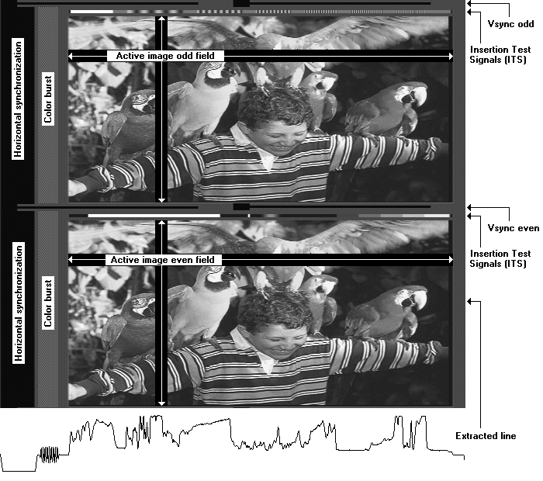
NTSC Description
1LINE
www.shmt.co.kr

Slide 4
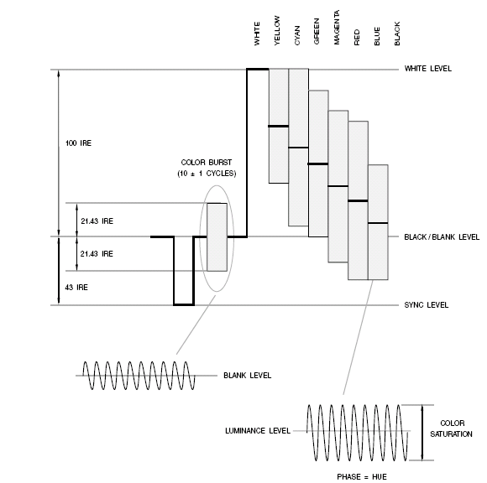
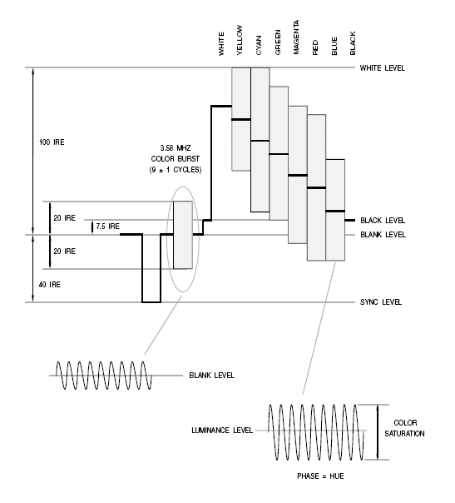
Simple color wave format
IRE(Institute of Radio Engineers) :: 140IRE 0~1.0v
Luminance
chrominance
www.shmt.co.kr

Slide 5
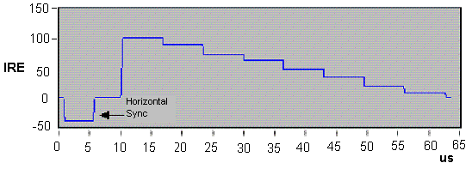
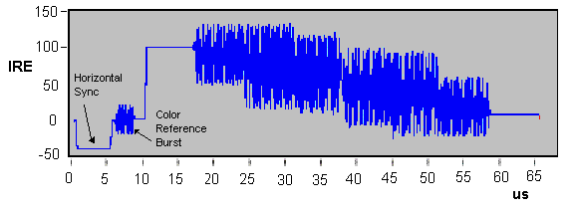
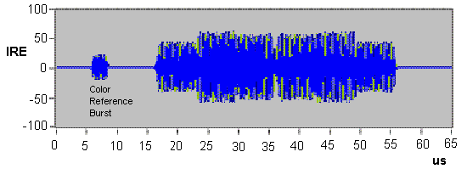
Composite signal generation
NTSC
  NTSC = Y + U sin ωt + V cos ωt + timing
  Y = 0.299R´ + 0.587G´ + 0.114B´
  U = 0.492(B´ – Y)
  V = 0.877(R´ – Y)
PAL
  NTSC = Y + U sin ωt ± V cos ωt + timing
www.shmt.co.kr

Slide 6
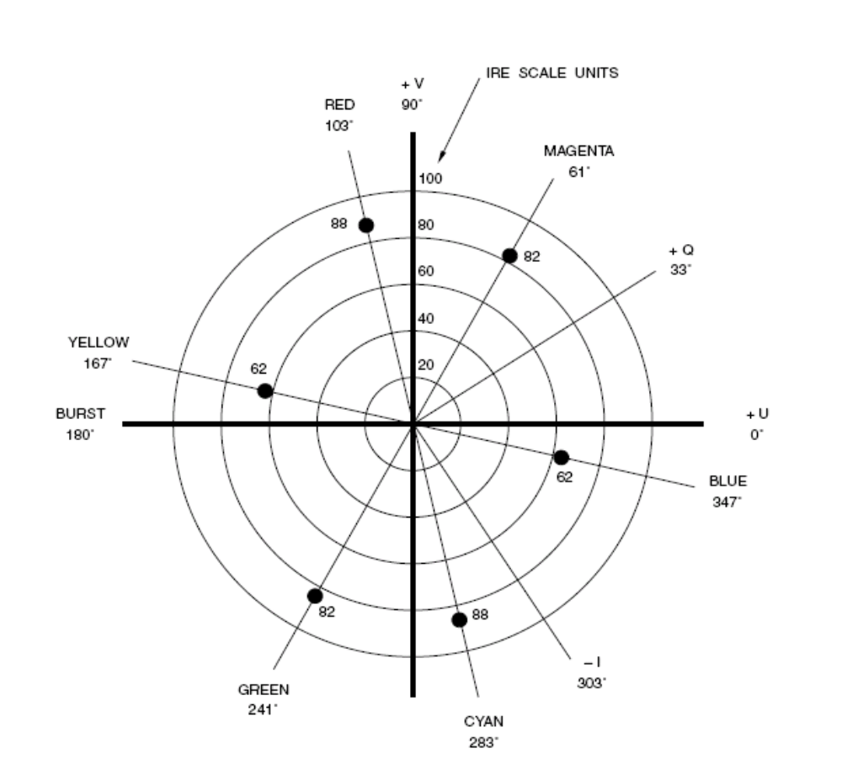
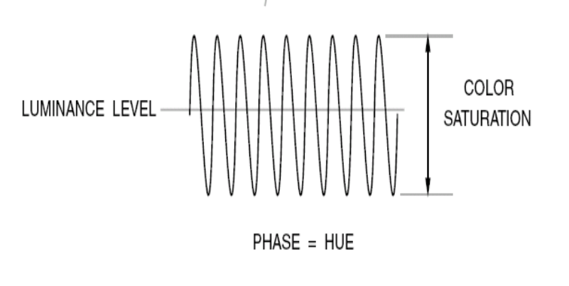
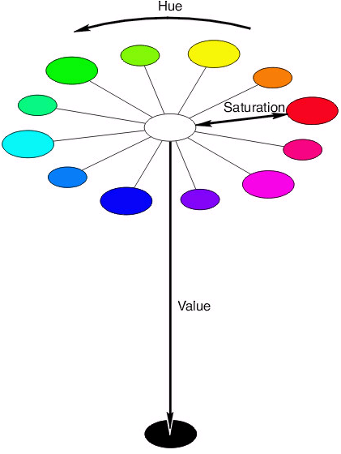
Chrominance
Chrominance = U sin ωt + V cos ωt
www.shmt.co.kr

Slide 7
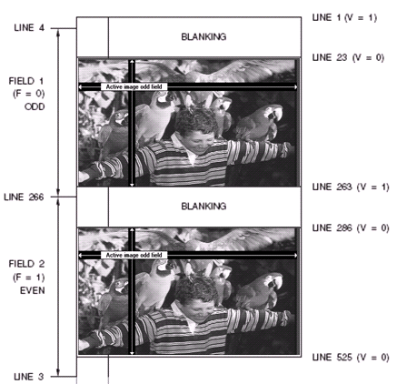
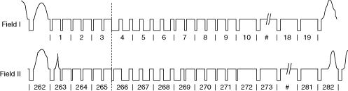
NTSC FRAME
Picture
field 전환
ODD FIELD
EVEN FIELD

Slide 8

TIMING
.
.
.
.
.
525
12.15Mhz
63.556 us
52.66 us
line duration : 63.556 microsec
active horizontal duration : 52.66 microsec
FH = 525line/frame x 30frame/sec
= 15750 line/sec = 15.7kHz
640 pixel/line = 12.15e6 pixel/sec x 52.66e-6 sec
www.shmt.co.kr

Slide 9
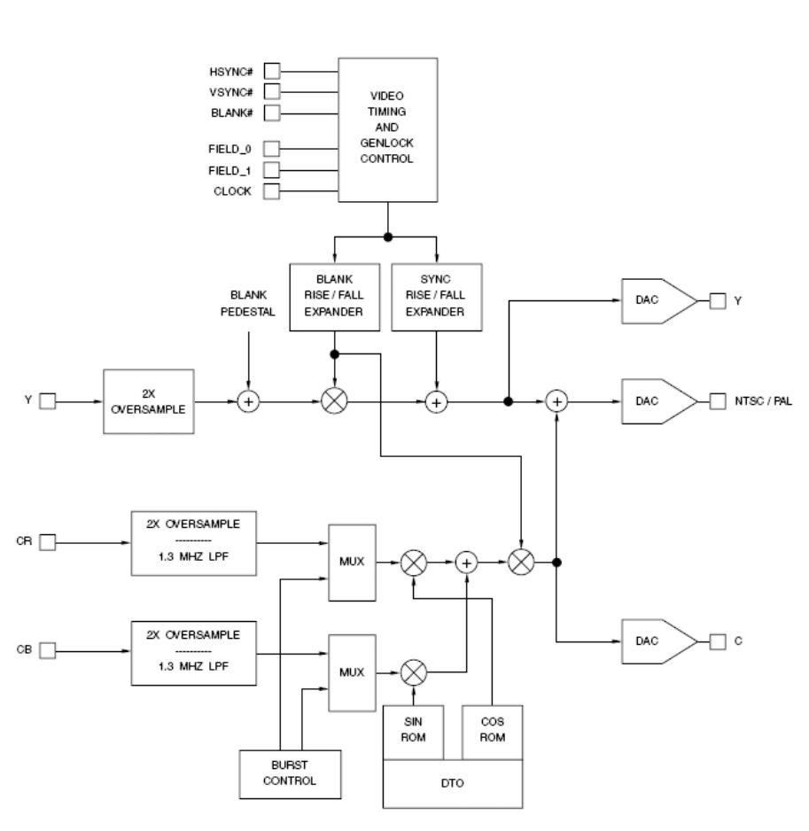
NTSC Encoder
Color Space Conversion
Analog Luminance (Y) Generation
Analog Chrominance (C) Generation
Black Burst Video Signal
Analog Composite Video
Color Subcarrier Generation
Horizontal and Vertical Timing
www.shmt.co.kr

Slide 10
ENCODER
FILTER
RGB
Out
CONVERSION
YCbCr
+
Y
FILTER
U
V
FILTER
TIMING
SIN/COS
gen
FILTER
www.shmt.co.kr

Slide 11
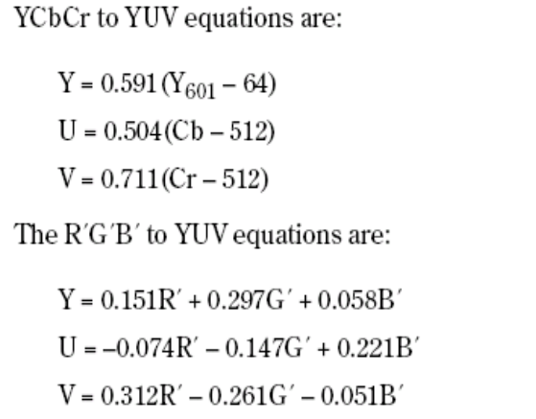
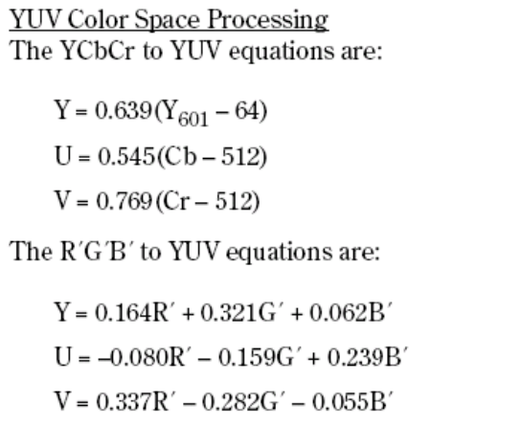
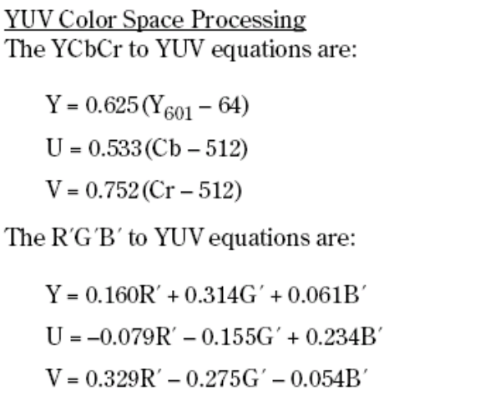
Color Space Conversion
(M) NTSC, (M, N) PAL
NTSC–J
(B, D, G, H, I, NC) PAL
www.shmt.co.kr

Slide 12
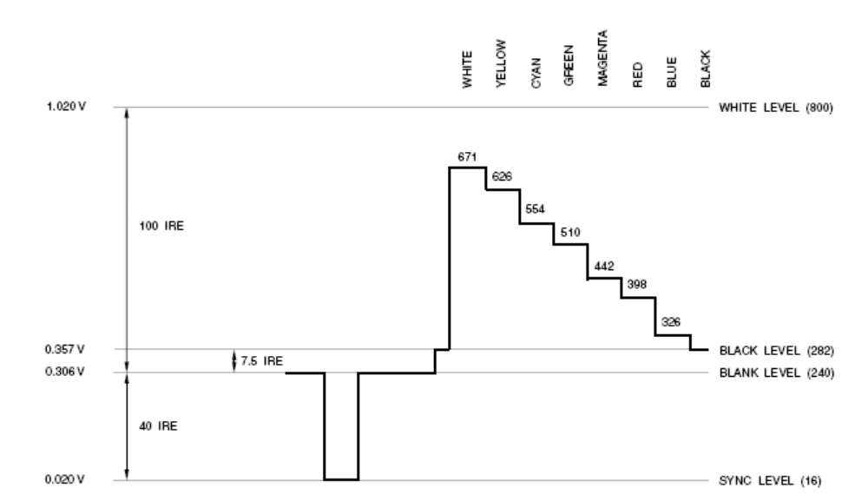
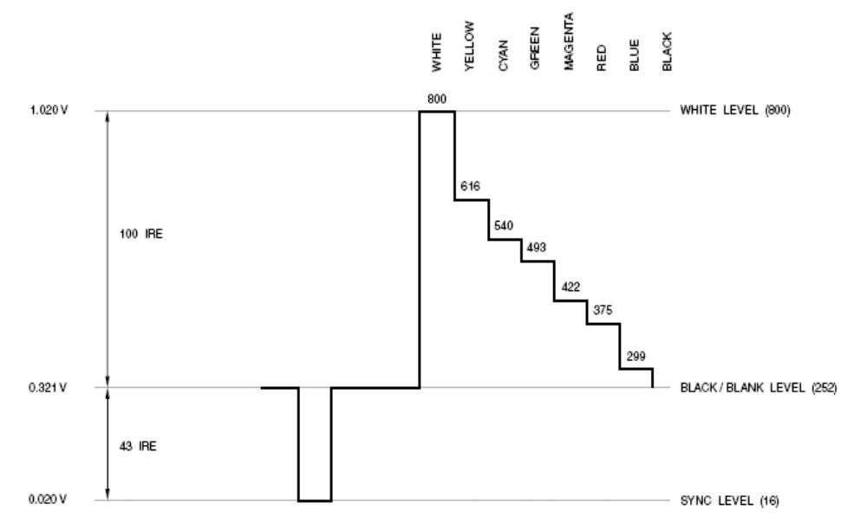
Analog Luminance (Y) Generation
(B, D, G, H, I) PAL Luminance
(M) NTSC Luminance
www.shmt.co.kr

Slide 13

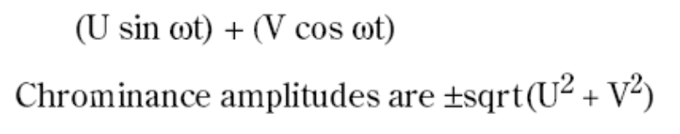
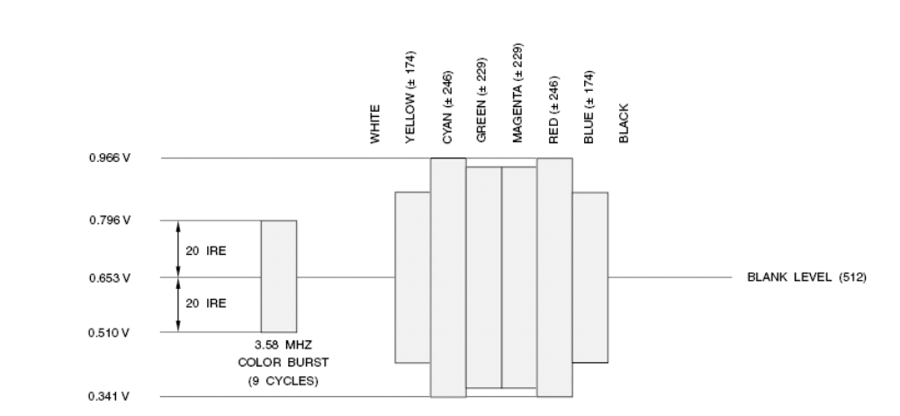
Analog Chrominance (C) Generation
www.shmt.co.kr

Slide 14
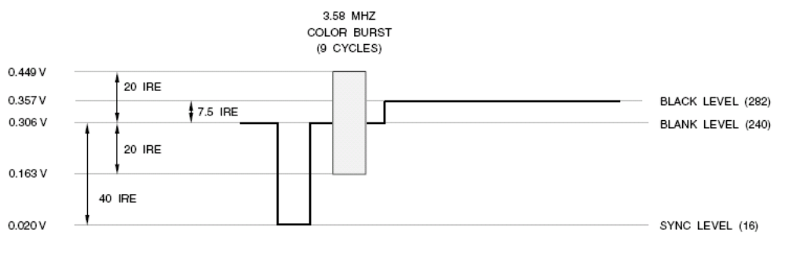
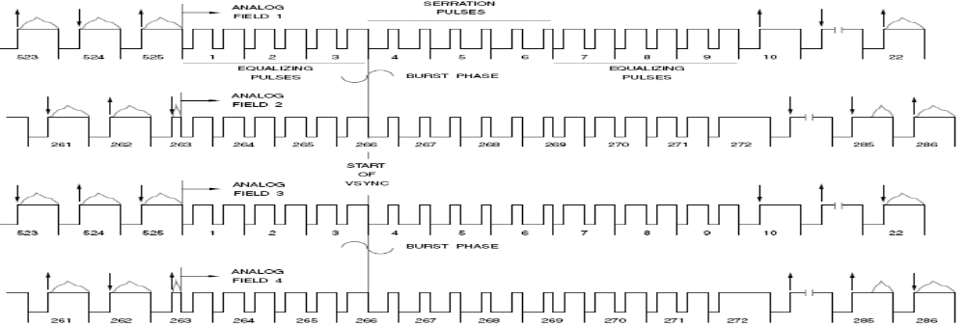
Black Burst Video Signal (NTSC)
BURST BEGINS WITH POSITIVE HALF-CYCLE
BURST PHASE = 180° RELATIVE TO U
BURST BEGINS WITH NEGATIVE HALF-CYCLE
BURST PHASE = 180° RELATIVE TO U
www.shmt.co.kr

Slide 15
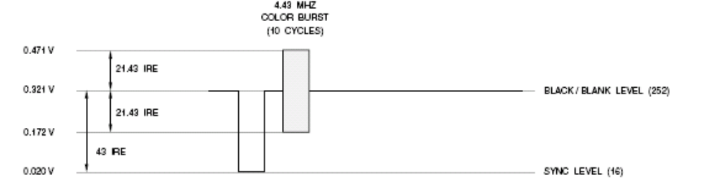
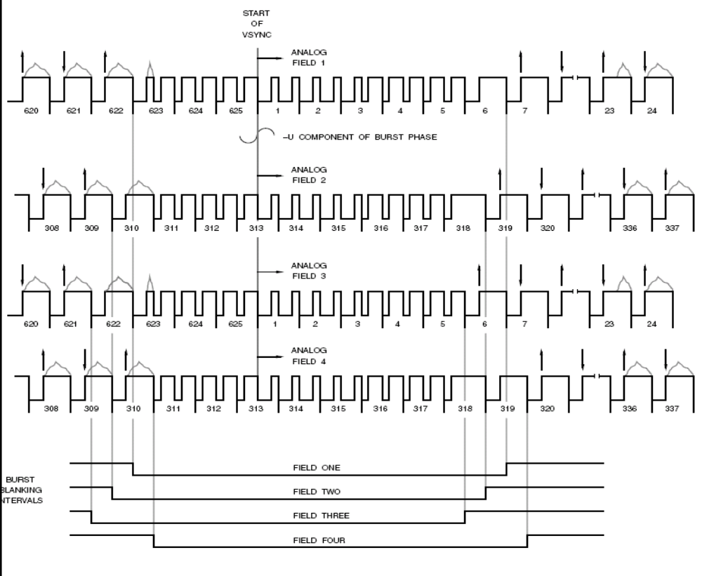
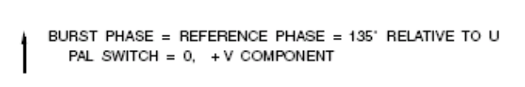

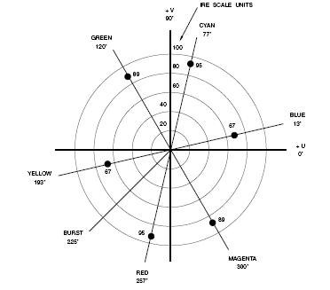
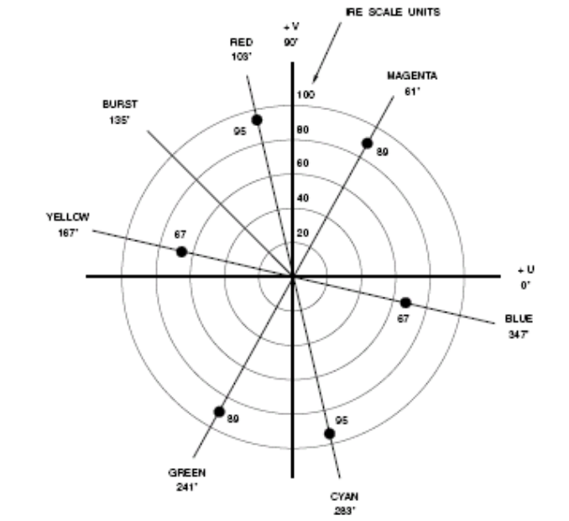
Black Burst Video Signal (PAL)
Burst
U
Burst
www.shmt.co.kr

Slide 16
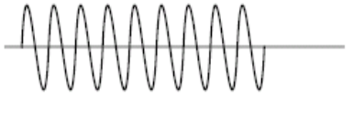
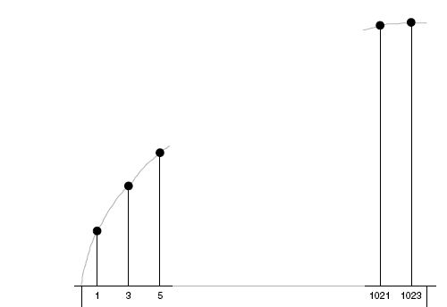
Color Subcarrier Generation
Level
change
Add
3.5Mhz sin/cos
13.5MHz
Counter
2048
SIN ROM (90°)
512level
SIN ROM (90°)
512level
1024 ~ 2048
0 ~ 1023
Burst
www.shmt.co.kr

Slide 17
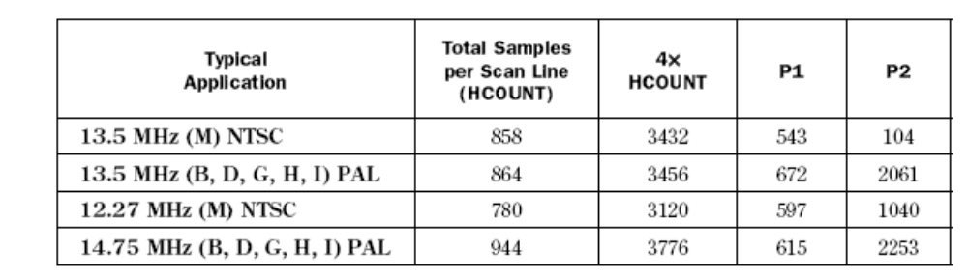
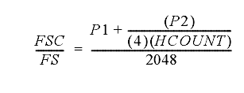
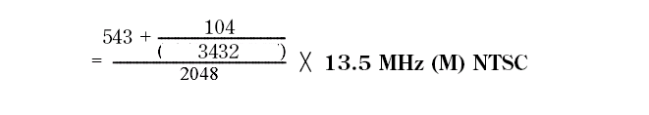
Color Subcarrier Generation
FSC :: 3.5Mhz (NTSC)
U
www.shmt.co.kr

Slide 18
NTSC Decoder
Digitizing the Analog Video
Y/C Separation
Color Difference Processing
Color Space Conversion
Video Timing Generation
www.shmt.co.kr

Slide 19
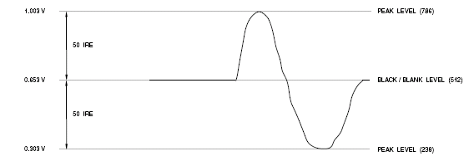
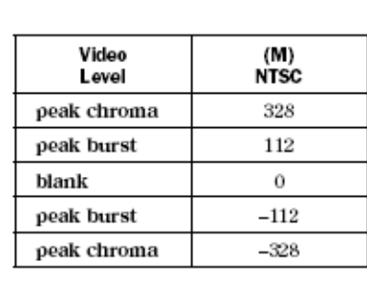
Digitizing the Analog Video
75%->100%
x0.25/x2
Blank Level Determination
Video Gain Options
Sync Amplitude AGC
Burst Amplitude AGC
6Mhz
ADC
Low pass
Filter
Gain
adjust
DC
Restoration
AGC
512
www.shmt.co.kr

Slide 20
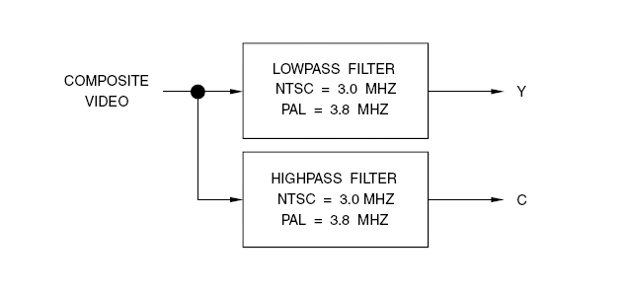
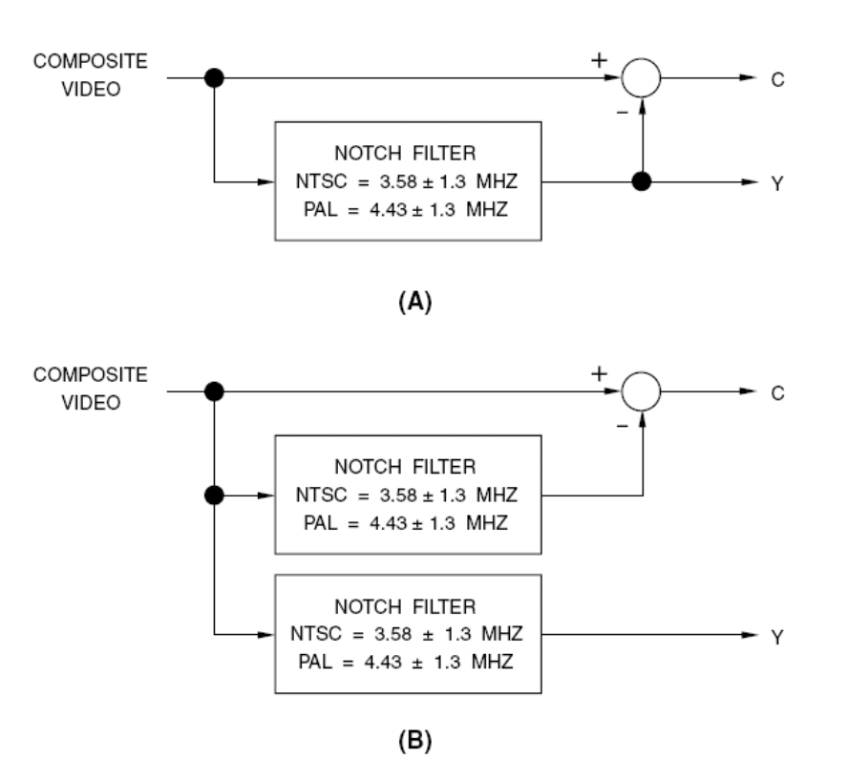
Y/C Separation
Simple Y/C Separation
www.shmt.co.kr

Slide 21
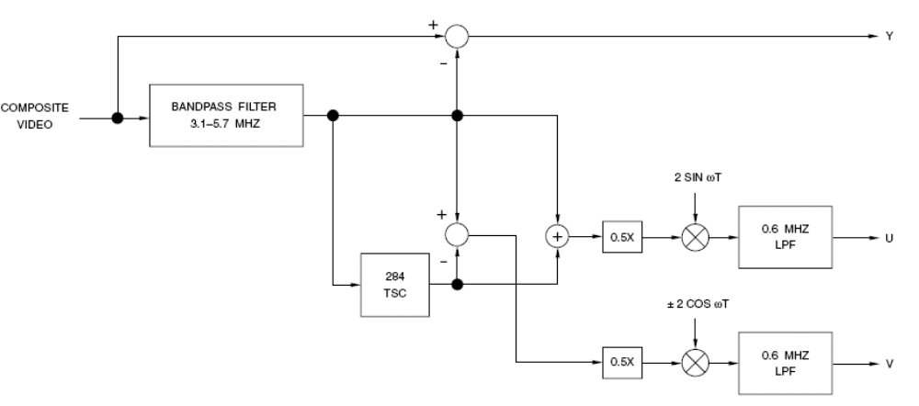
Y/C Separation
PAL Y/C separation
Y + U sin wt + V cos wt
Y
2x(U sin wt)
U sin wt + V cos wt
U sin wt - V cos wt
2x(V sin wt)
www.shmt.co.kr

Slide 22
Color Difference Processing
(M) NTSC, NTSC–J
(U sin ωt) + (V cos ωt)
  ((U sin ωt) + (V cos ωt)) (2 sin ωt)
  = U – (U cos 2ωt) + (V sin 2ωt) ➔ U(filter)
  ((U sin ωt) + (V cos ωt)) (2 cos ωt)
  = V + (V cos 2ωt) + (U sin 2ωt) ➔ V(filter)
www.shmt.co.kr

Slide 23
END
www.shmt.co.kr

